Slide 1
Network Analytics Team Members
Renato Barroco & Joaquin Gianantonio
Notes:
This is the slide where you actually SAY your 1-2 sentence elevator pitch. Engage your audience!!

Slide 2
Presentation Outline
1
Definition of the Problem
Our Proposed MLE Solution
Information about the Data & Model
Demo
MLE Stack
Conclusions (and lessons learned)
Future Work

Slide 3
Definition of the Problem
Network infrastructures are at risk from cyber-attacks and intrusions.
This is an increasing concern as we continue to expand the applications of modern-day networking: i.e., Internet Of Things, smart homes, etc.
Cyber-attacks and intrusions can compromise their availability, confidentiality, and integrity.
But these threats are difficult to detect unaided: they display network traffic patterns almost indistinguishable from normal traffic.
Notes:
Specify what Problem is being solved, and ensure that everyone is in agreement as to Why that’s a problem.

Slide 4
Our Proposed Solution
We propose developing a ML-based Network Intrusion Detection (NID) system that can provide rapid identification of potential intrusions.
We also plan to test a DL-based (CNN) solution to see if we get better results [define results].
This NID will:
let network administrators take corrective action to cancel these threats.
let network designers develop responses based on information from the NID.
The NID will help reduce interruption of service and avoid or reduce interrupting critical tasks and its associated cost for the user and provider.
The NID will have to monitor network flow (at port level), and robustly identify threats.
Notes:
Specify what Success looks like, and for what Audience.

Slide 5
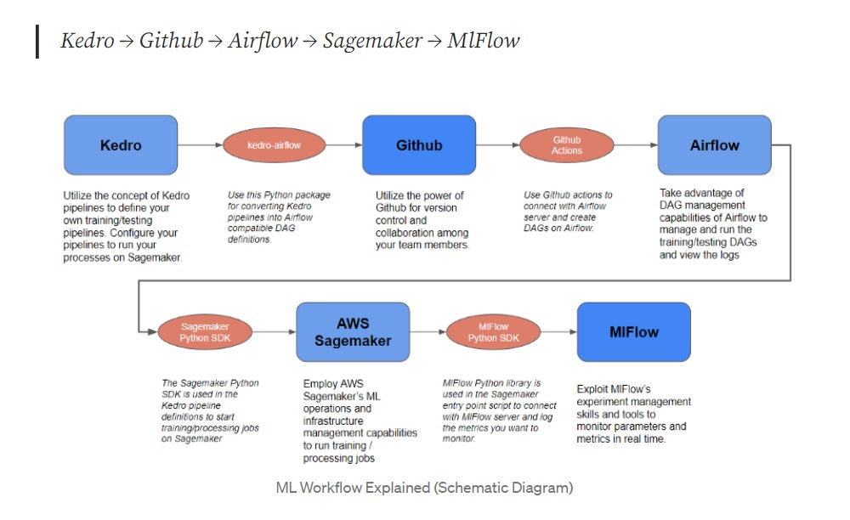
Our Proposed Solution
Source: https://write.agrevolution.in/ds-pipeline-the-much-needed-data-science-infrastructure-design-part-1-the-concept-4ceb57944974
Notes:
Specify what Success looks like, and for what Audience.

Slide 6
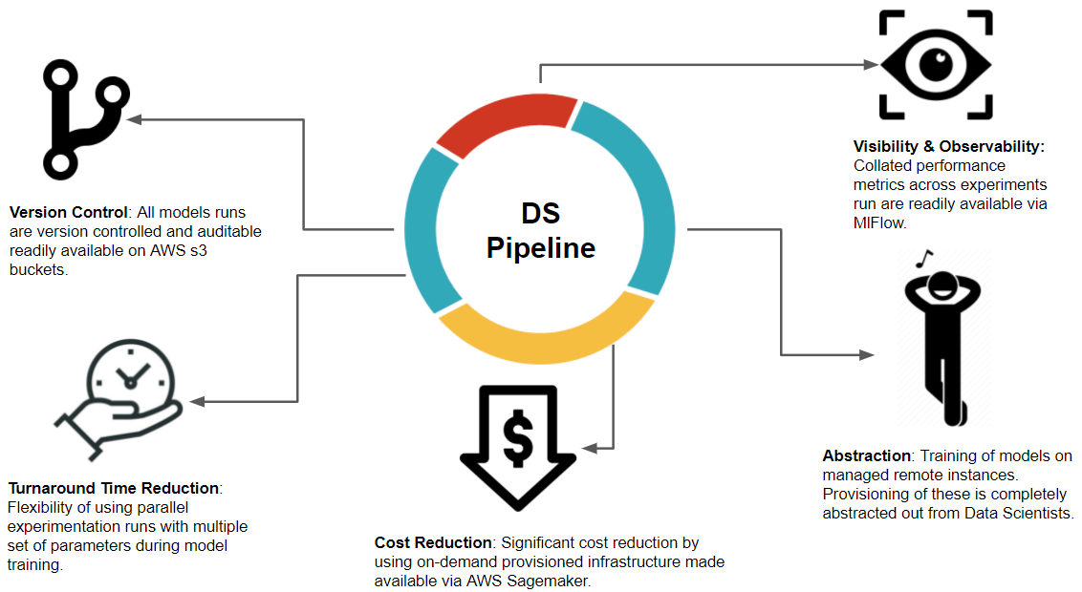
MLE Stack
Use pipelines

Slide 7
MLE Stack (initial proposal)
Reusable Code Structure for building ML Models
Experiment Tracking with model Artifacts
Training of Models on Managed Remote instances
Version control of Trained models
Git-based triggers to train and deploy models
Deployment of Trained models on Managed Remote instances
Monitoring and Logging of deployed models
Integration of Deployed endpoints with API Gateway

Slide 8
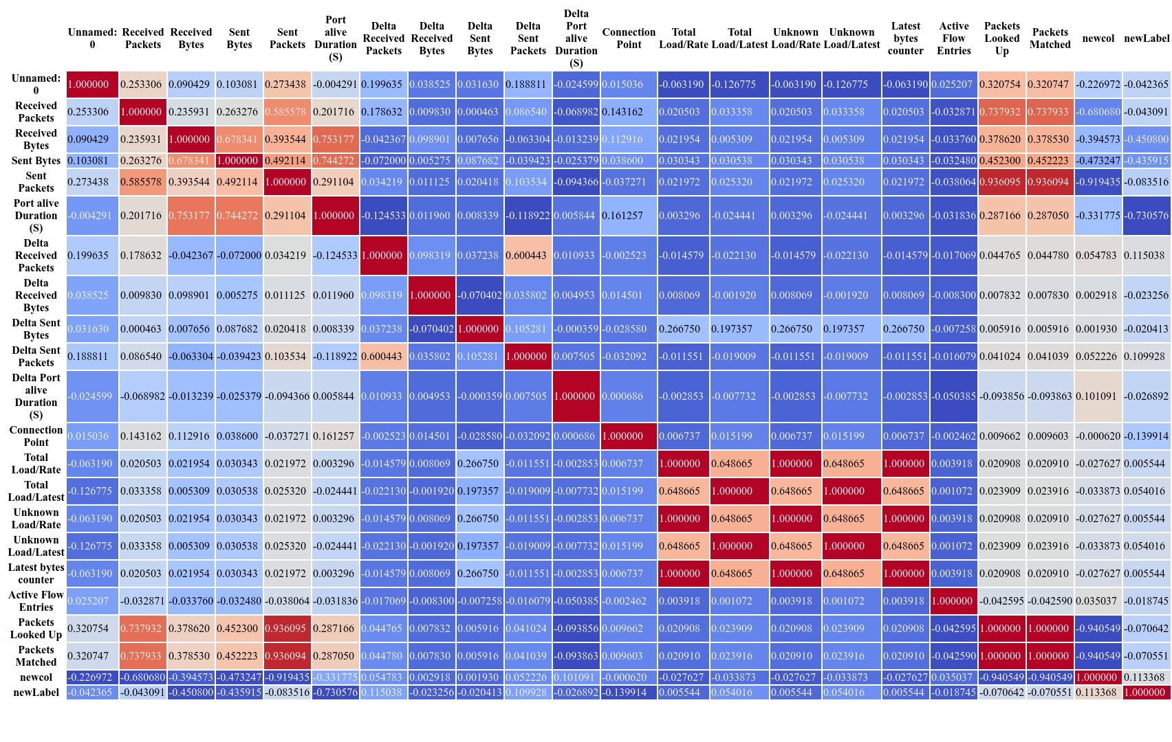
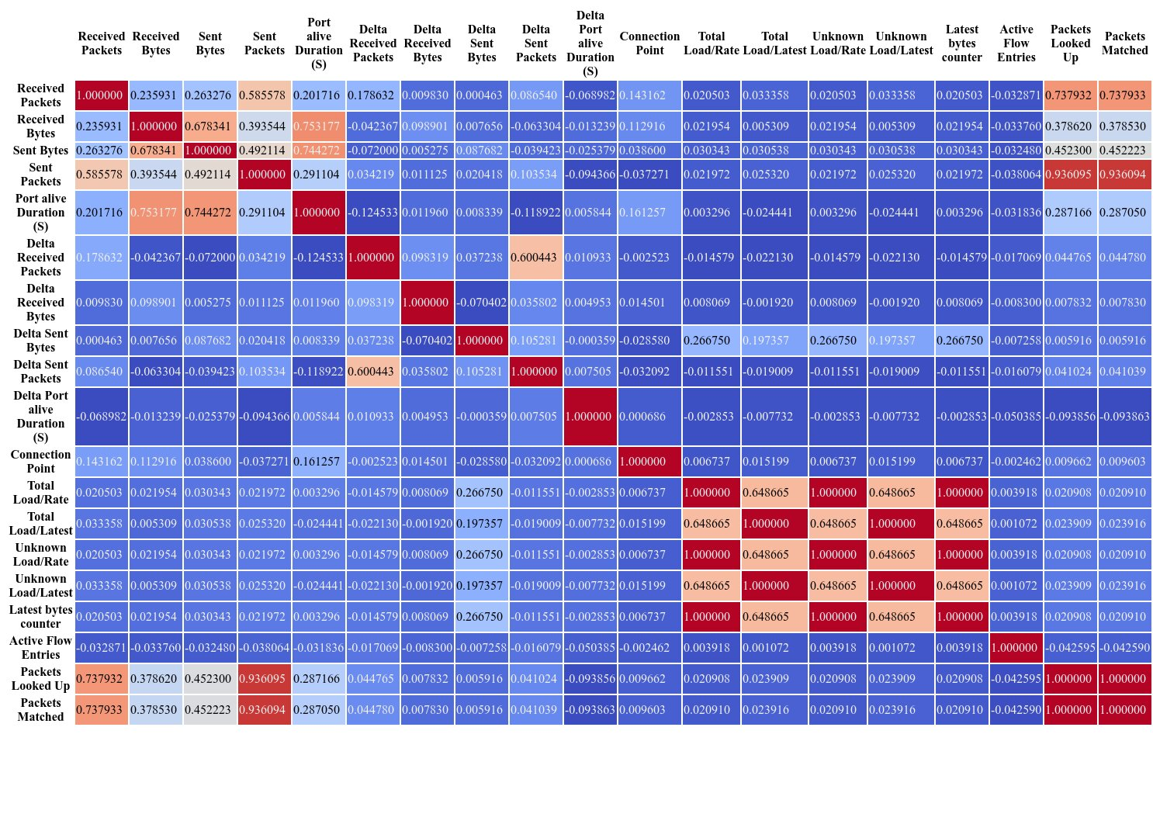
MLE Stack
EDA performed on dataset

Slide 9
MLE Stack
Used Logistic Regression to run simple predictions for binary and for multi class classification.
Used TPOT to determine best pipeline for a (multi-class) classifier: a gradient boosting classifier (XGBClassifier).

Slide 10
Information about the Data [& Model]
We expect to gain a deeper understanding of network traffic classification based on network traffic data and the use of ML models.
Our proposed dataset (UNR-IDD) is based on a custom application that collects and logs the available statistics captured periodically (every 5 sec – tumbling windows) from OpenFlow switches. Delta port statistics are also computed.
We expect that the use of a multi-label classification for network analysis will provide a robust identification of network flow, giving (a Security Team) a better understanding of the type of port flow.
The model Network Intrusion Detection should be deployed to be hit from an API or some sort of streaming process/batch load as events are generated. (Dashboard)
Which model to use still to be determined, but many will be tested;
Source: Tapadhir Das - UNR-IDD Dataset

Slide 11
Information about the data (Multi-class classification)

Slide 12
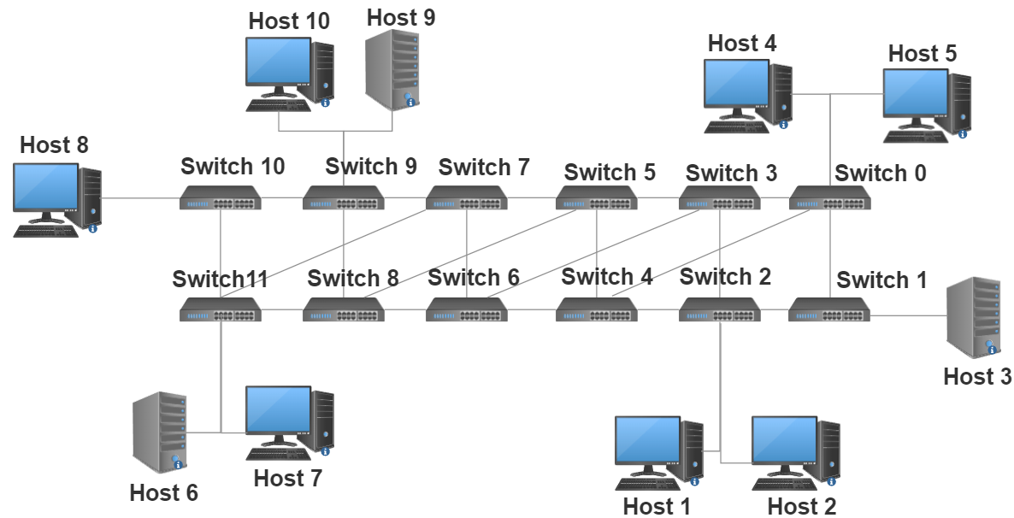
Information about the data (network topology)
Flow Simulation: IPerf is used to create TCP and UDP data streams simulating network flows in virtual and real networks using dummy payloads.
Data Collection: we create a custom application to collect and log the available statistics that are captured periodically (once in every 5 seconds) from OpenFlow (OF) switches. The statistics are collected through by means of OFPPortStatsRequest and OFPPortStatsReply messages between controller and switches.
Source: Tapadhir Das - UNR-IDD Dataset

Slide 13
Information about the data (network topology)

Slide 14
Industry insights
Deep Learning for Network Traffic Monitoring and Analysis (NTMA)
https://www.sciencedirect.com/science/article/pii/S0140366421000426#b96
The experiments revealed that DL models provides better accuracy (with 99.20%) than the classical ML models (with 95.22%).
The authors claimed that in highly distributed networks, such as IoT systems, the traditional techniques such as classical ML techniques for NTMA purposes (e.g., attack detection) have less scalability. As a result, they proposed edge-based deep learning to deal with modern communication systems’ distributed and complex nature. The vast amount of data generated by IoT edge devices allow DL models to learn more useful than classical ML models.
https://learn.microsoft.com/en-us/azure//streaiot-hub/iot-hub-live-data-visualization-in-power-bi
https://www.databricks.com/blog/2022/05/05ming-windows-event-logs-into-the-cybersecurity-lakehouse.html
Notes:
Specify what Success looks like, and for what Audience.

Slide 15
Exploration model – DeepInsight with Squeezenet
DeepInsight:
A methodology to transform a non-image data to an image for convolution neural network architecture
https://www.nature.com/articles/s41598-019-47765-6
Examples:
https://github.com/alok-ai-lab/pyDeepInsight/blob/75ac7e62d5c10c35828b76bd547ec9e66960303c/examples/pytorch_squeezenet.ipynb
Notes:
Specify what Success looks like, and for what Audience.

Slide 16
DeepInsight pipeline
If the data dimensionality is extremely large and difficult to handle due to hardware limitations, then the dimensionality reduction technique (DRT) may be considered before applying DeepInsight.
The DRT can be either in the form of feature selection or feature extraction depending upon the nature of the problem.
The application of DRT will provide a small feature set which will help in faster processing, however, can risk classification performance. On the other hand, if noisy or redundant features are removed then it could help to get higher processing speed as well as better accuracy. Since the application of DRT is case dependent, we have described DeepInsight without applying DRT.
Notes:
Specify what Success looks like, and for what Audience.

Slide 17
DeepInsight pipeline
The conversion from Cartesian coordinates to pixel frames is done by averaging some features as the image size has a pixel limitation.
Drawbacks and concerns:
1) If the resolution of image or grid size is very small (compared to the number of features given), then many features overlap with each other, and image representation may not be very accurate. An appropriate resolution should be selected given the hardware capacity and the number of features required to process. Alternatively, dimensionality reduction may be applied a priori.
2) The authors acknowledge the fact that classical ML algorithms that employ experts- and manually-based methods for feature extraction are not appropriate for modern networks due to: (1) handheld devices’ massive deployment, such as smartphones and tablets, considerably increases mobile traffic volume, (2) the massive adoption of the encrypted network protocols, e.g., Transport Layer Security (TLS), reduces the effectiveness of DPI techniques based on ML algorithms, and (3) considering the ever-increasing development of mobile applications and the changing nature of mobile traffic, implementing up-to-date and accurate traffic classifiers through classical ML algorithms is challenging.
Notes:
Specify what Success looks like, and for what Audience.

Slide 18
Models
Aceto et al. [x] studied DL-based models for mobile traffic classification. They reproduced several DL classifiers, e.g., MLP, LSTM, CNN, and SAE, from the traffic classification literature in order to make a comprehensive evaluation for showing the accuracy of these classifiers.
Among DL-based classifiers, the best performance is related to 1D-CNN with 76.37%/85.70% accuracy and the F-measure of 75.56%/78.78% on FB-FBM and Android dataset, respectively.
Notes:
Specify what Success looks like, and for what Audience.

Slide 19
Models (industry)
https://www.nature.com/articles/s41598-019-47765-6
As mentioned, one of the main advantages of CNNs compared to conventional neural networks is the automatic detection of the important features and hierarchical feature extraction. A simple CNN model proposed in [93] for the categorization of encrypted traffic. This paper is one of the first works leveraging CNNs in the context of traffic classification, in which encrypted traffic is transformed into two-dimensional images, and then the images fed into the CNN model to be classified.
The authors reported an accuracy of 1D-CNN 1%, 82%, 98%, and 86%, and 2D-CNN 1%, 80%, 97%, and 84% for four different experiments, respectively. The main advantages of the method presented in this work over the existing traffic classifiers, such as classical ML classifiers, include:
(1) integrating feature extraction/selection/classification phases into an end-to-end framework;
(2) categorization of the encrypted network traffic which is a challenging task for the traditional classifiers
Notes:
Specify what Success looks like, and for what Audience.

Slide 20
Models (industry)
https://www.nature.com/articles/s41598-019-47765-6
In [94], the authors also adopted the CNN model for IP traffic classification. They converted sequences into images that fully represent the patterns of different applications, such as Facebook and Instagram. Then, the CNN model is employed to classify the images to different applications. Rezaei and Liu proposed a one-dimensional CNN-based semi-supervised approach to categorize five Google applications [95]. To reduce the need for large labeled traffic datasets, first, the model is pre-trained on a big unlabeled training test where the time series characteristics of a few samples of packets are considered as the input.
The proposed method’s performance is evaluated with different sampling techniques (i.e., fixed step sampling, random sampling, and incremental sampling) on three different datasets, including the QUIC dataset, Unlabeled Waikato dataset, and Ariel dataset. The proposed pre-trained method achieved higher accuracy than its non-pre-trained counterpart, with 81.50%, 81.27%, and 80.76% on the QUIC dataset for the sampling techniques. As mentioned, the authors use a 1D-CNN as a classifier because they believe the using of new applications and network encryption techniques have considerably raised the complexity of the traffic classification tasks, mainly when one uses classical ML-based methods.
Notes:
Specify what Success looks like, and for what Audience.

Slide 21
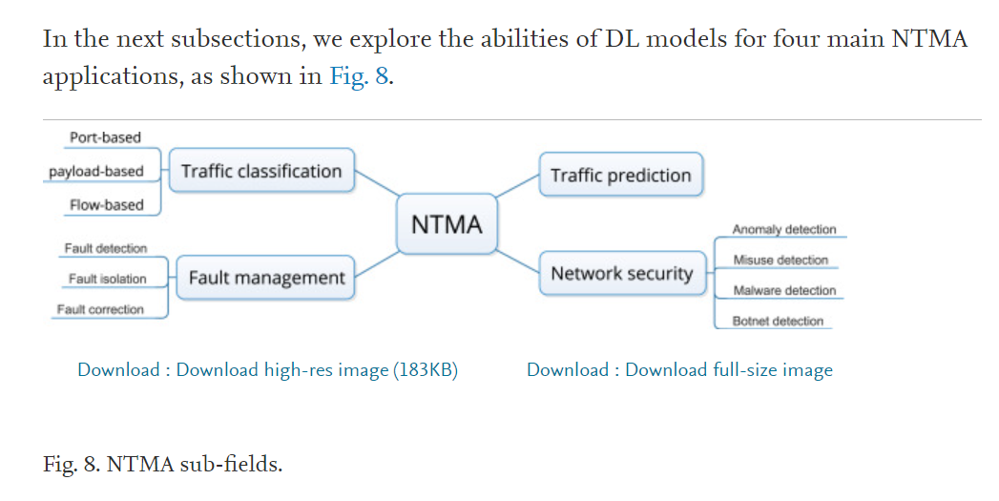
Industry insights
Notes:
Specify what Success looks like, and for what Audience.

Slide 22

Demo (2 min)

Slide 23
Challenges
Full workflow implementation;
Cost of using AWS Sagemaker? Is the free access enough for all the iterations needed?
Deployment in a dashboard? What tool to use?
How to simulate or use real data to validate/test the solution?
How often a model like that would need to be retrained to reflect the dataset/data drift?

Slide 24
Conclusions (90 s)
We learned to do end-to-end ML the easy way, the hard way is to be able to monitor the model daily; mapping data drift and applying re-training the model using devOps solutions;
Important aspect of any MLE solution is the data engineering part of the project;
The lessons… real-time data analysis can be expensive and not efficient if not used properly; that is why data engineering is such an important part of any project;
Notes:
This is where you can tell funny stories about the stupid things you did!
This is also the slide where you might convey the difference between what you set out out to do, and what you actually did.

Slide 25
Future Work (30 s)
Real time streaming using KAFKA, Auloader & Databricks delta lake for real-time threat detection;
Dashboarding using plotly, databricks env;
Data drift analysis with a robust devOps, CICD deployment;

Slide 26
Thank You! Questions?

Slide 28
Information about the data (network topology)
Delta Port Statistic | Description
Delta Received Packets | Number of packets received by the port
Delta Received Bytes | Number of bytes received by the port
Delta Sent Packets | Number of packets sent by the port
Delta Sent Bytes | Number of bytes sent
Delta Port alive Duration | The time port has been alive in seconds
Delta Packets Rx Dropped | Number of packets dropped by the receiver
Delta Packets Tx Dropped | Number of packets dropped by the sender
Delta Packets Rx Errors | Number of transmit errors
Delta Packets Tx Errors | Number of receive errors

Slide 29
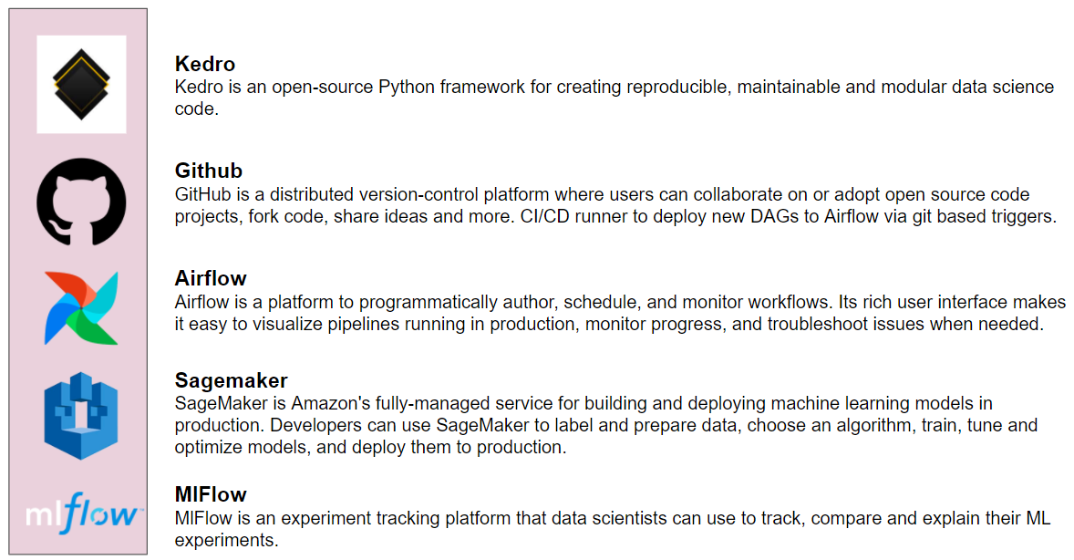
MLE Stack (2 min)
Source: https://write.agrevolution.in/ds-pipeline-the-much-needed-data-science-infrastructure-design-part-1-the-concept-4ceb57944974

Slide 30
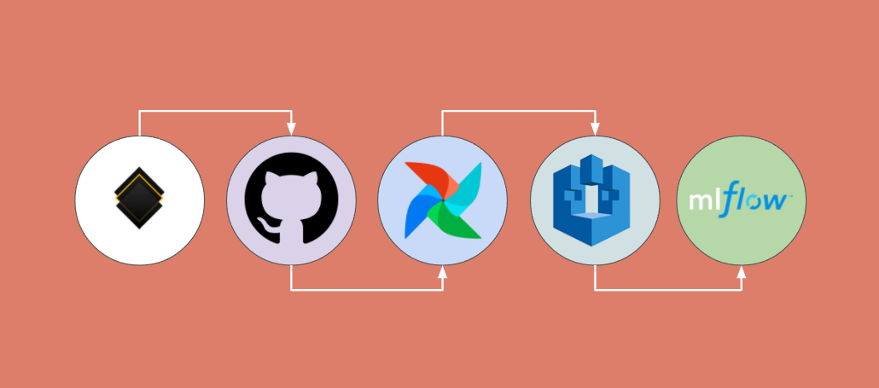
MLE Stack (2 min)
Source: https://write.agrevolution.in/ds-pipeline-the-much-needed-data-science-infrastructure-design-part-1-the-concept-4ceb57944974

